Slide 1
Towards Privacy-Preserving Evaluation for Information Retrieval Models over Industry Data Sets
Peilin Yang, Hui Fang
University of Delaware
Mianwei Zhou
PlusAI
Yi Cheng
Huawei Research America
Chengxiang Zhai
University of Illinois Urbana-Champaign

Slide 2

Information Retrieval System
User
IR system is actually the intermediate layer between user and data.
Data is valuable, thus sometimes unavailable to the users☹
IR System
Dataset/Corpus

Slide 3



Ideally…
Upload to centralized evaluation system
OR evaluate at local
Should not make any difference
Model Imple.

Slide 4


Ideally…
Upload to centralized evaluation system
OR evaluate at local
Should not make any difference
Unified Results

Slide 5


Data Availability
Public Datasets
in other research fields:
TREC
Industrial
Most IR datasets are private
Notes:
Almost the corpa of all TREC tracks are praviate: Newswire, Microblog, Medical, Legal, etc.

Slide 6
Information Retrieval System
User
Does the user really need to have direct access to the data?
Ans: Not Necessarily
IR System
Dataset/Corpus

Slide 7




Level Based Evaluation Platform
User Effort
System Capability

Slide 8
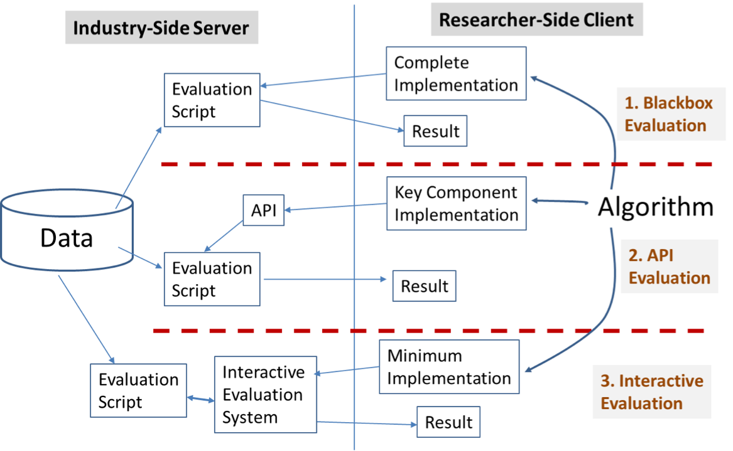
Level Based Evaluation Platform

Slide 9

Level Based Evaluation Platform
Explore the Index
Inspect the Results
…
Any Language

Slide 10
Level Based Evaluation Platform

Slide 11

Level Based Evaluation Platform
TF
IDF
DL
Implement via APIs
Model

Slide 12
Level Based Evaluation Platform

Slide 13

Level Based Evaluation Platform
BM25
Language Model
Learning to Rank
Can only pick one
with chosen parameter

Slide 14
Instantiation of the Idea
Privacy Preserving Evaluation (PPE)
https://rise.eecis.udel.edu/

Slide 15
PPE is an instance of level 2 evaluation

Slide 16



PPE - Privacy Preserving Evaluation
Docs
Unavailable for Academia
But are Super Valuable
How to Use It?
Private Industrial
Data Collections
Logs
Judgments

Slide 17
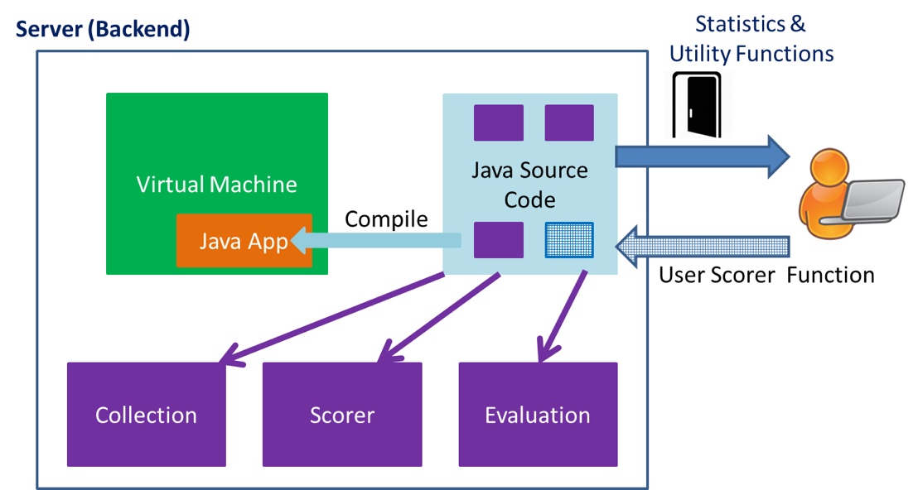
PPE Framework

Slide 18
Experiments on PPE
Collection | IC | ROBUST04 | WT2G | GOV2
#queries | 3,274 | 250 | 50 | 150
avg(ql) | 2.80 | 2.73 | 2.44 | 3.11
#docs | 71,406 | 528,155 | 247,491 | 25,205,179
avdl | 583.44 | 467.55 | 1057.59 | 937.25
* IC: Industrial Collection

Slide 19
Experiments on PPE
Collection | IC | IC Explain
#queries | 3,274 | More Queries
avg(ql) | 2.80 | Keyword Queries
#docs | 71,406 | Fewer Documents
avdl | 583.44 | News Articles
* IC: Industrial Collection

Slide 20
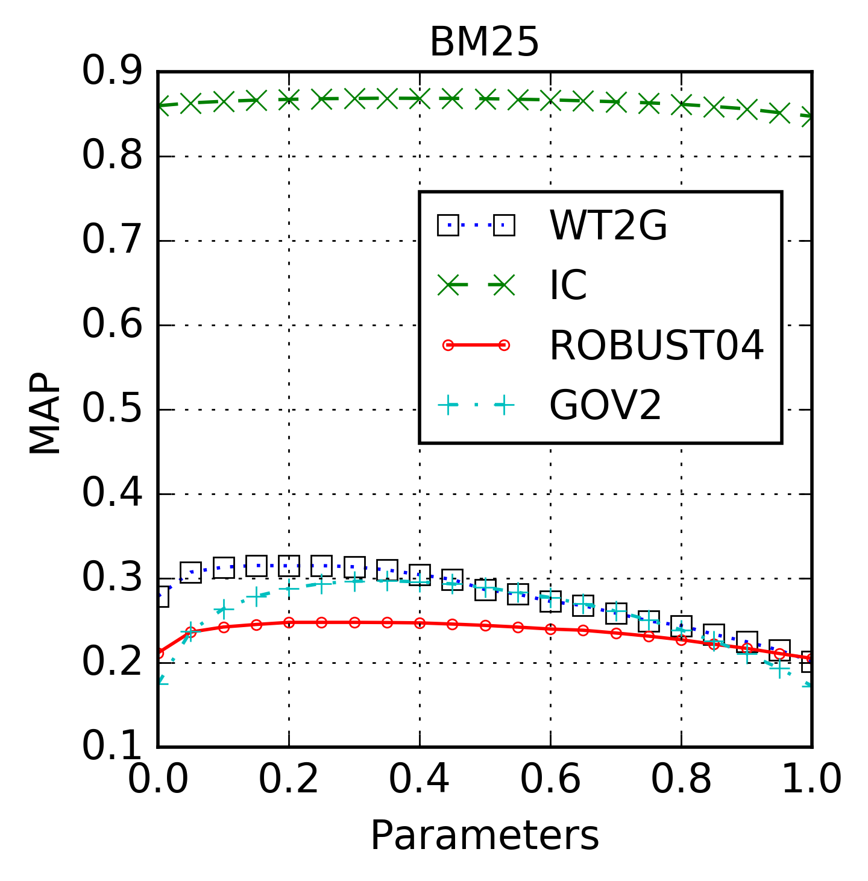
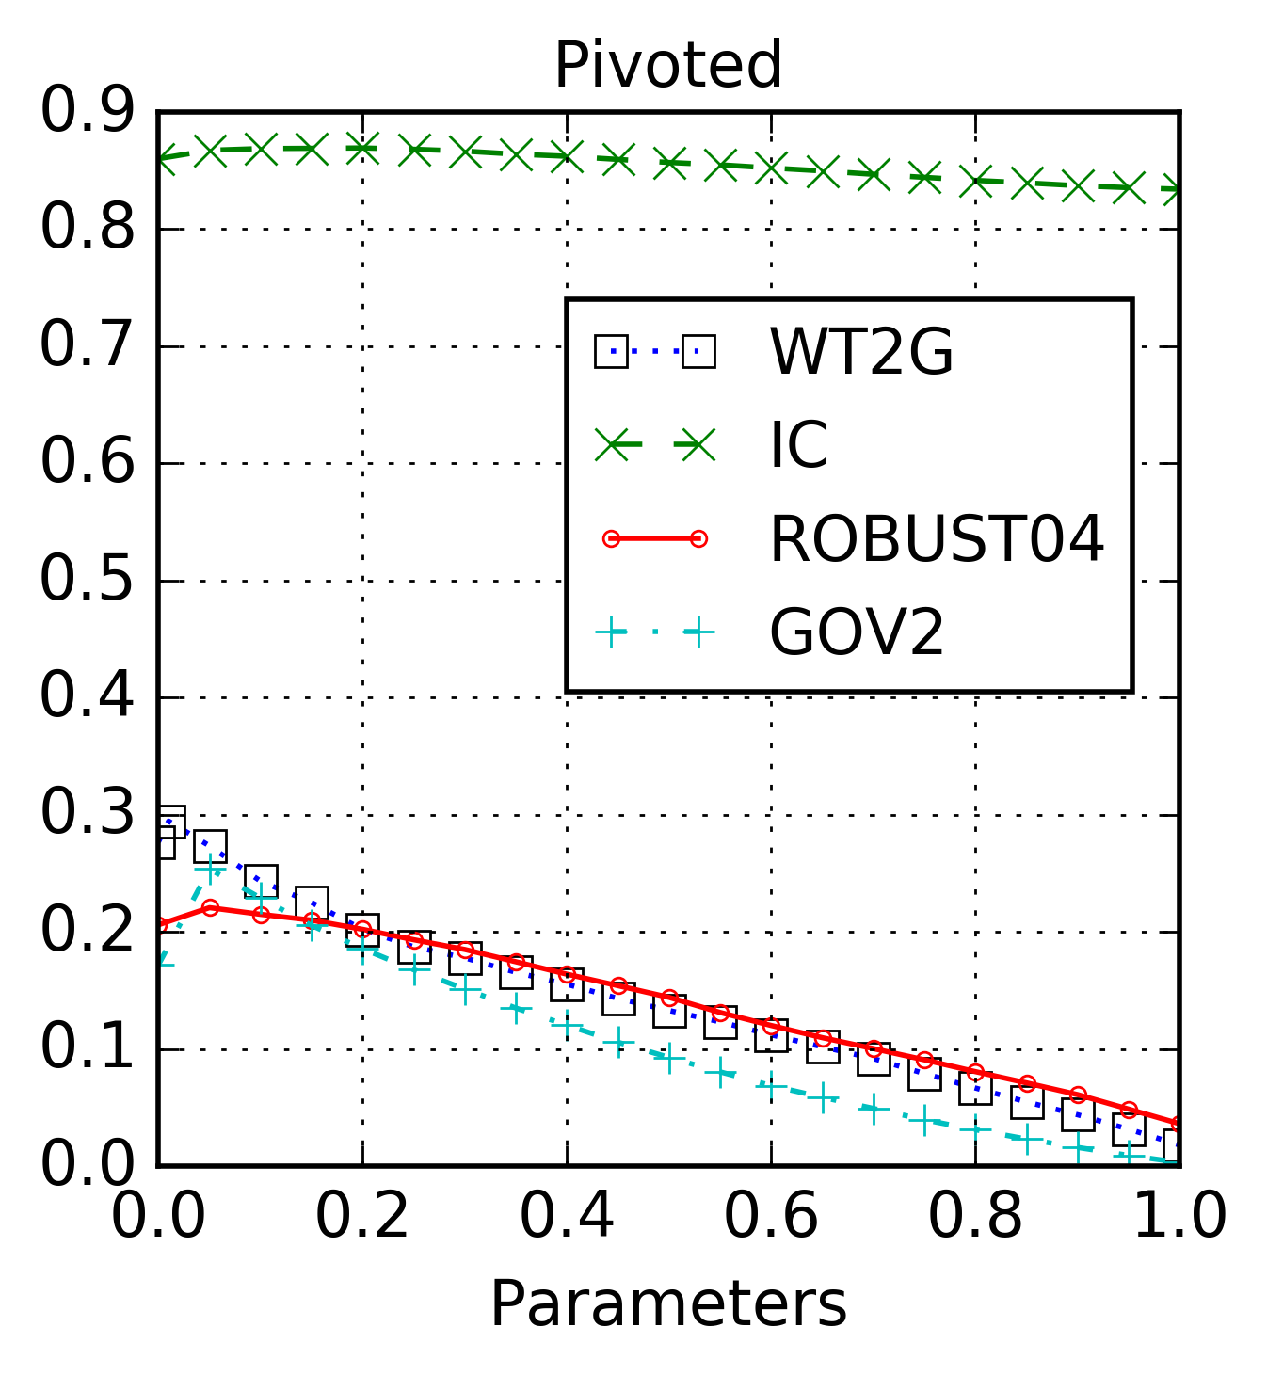
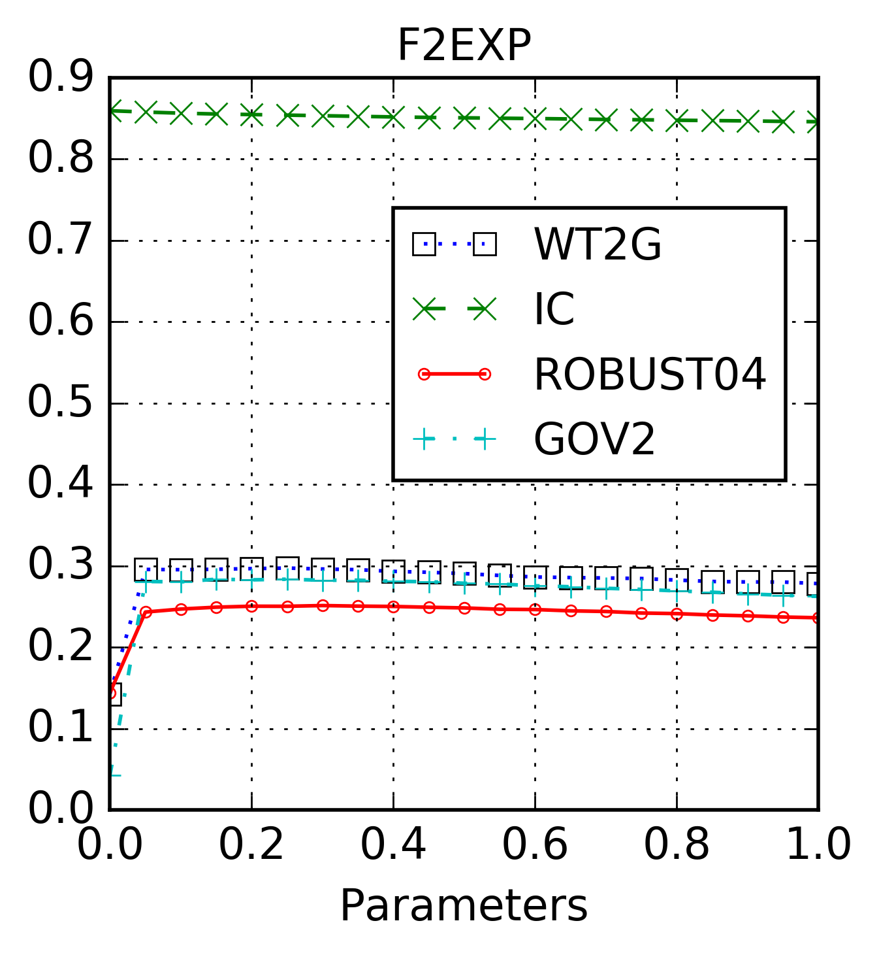
Experiments on PPE - Results
All ranking models perform well on IC
Parameters are not sensitive on IC

Slide 21


Experiments on PPE - Diagnostic Analysis
Medical Domain | IR Domain
patients | retrieval functions
diseases | problems of heuristic implementation,causes of non-optimal performance
medical records | existing findings in IR
symptoms | empirical results
medical instruments | relevance-preserved collection perturbations
medical tests | tests for retrieval models
treatments for disease | better implementations of heuristics,modification for performance improvement

Slide 22
Experiments on PPE - Diagnostic Analysis
Relevance-Preserving Perturbations
Name | Semantic
document scaling | concatenate D with itself K times
noise addition | add a noisy term to a document
internal term growth | add a term to a document that originally contains the term

Slide 23
Experiments on PPE - Diagnostic Analysis
What We Use
Length variance reduction test (LV1): This test is to use the document scaling perturbation to make all the documents have similar or identical length, and it would thus reduce the variance of document lengths.
Noise addition test (TN): This test is to add noise (i.e., nonrelevant terms) to documents.
All query term growth test (TG3): We perform the internal term growth perturbation for all query terms.

Slide 24
Experiments on PPE - Diagnostic Analysis
A Quantified View
Test | TF | |d| | avdl | |d|/avdl
LV1(beta=1) | k*TF | (1-beta)*|d|+beta*10^6 | (1-beta)*avdl+beta*10^6/N | compute using column |d| and avdl
TN1(constant) | TF | |d|+k | avdl+k | (|d|+k)/(avdl+k)
TG3(constant) | TF+|q|*k | |d|+|q|*k | avdl+|q|*k | （|d|+|q|*k]/[avdl+|q|*k）

Slide 25
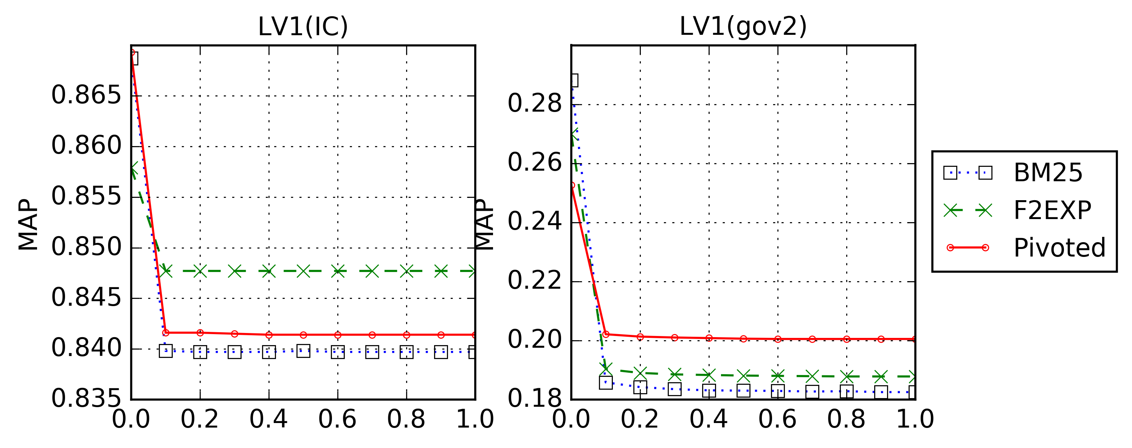
Diagnostic Analysis – LV1
Lower is Better
Means the gain on length normalization part
F2EXP does not gain too much on IC

Slide 26
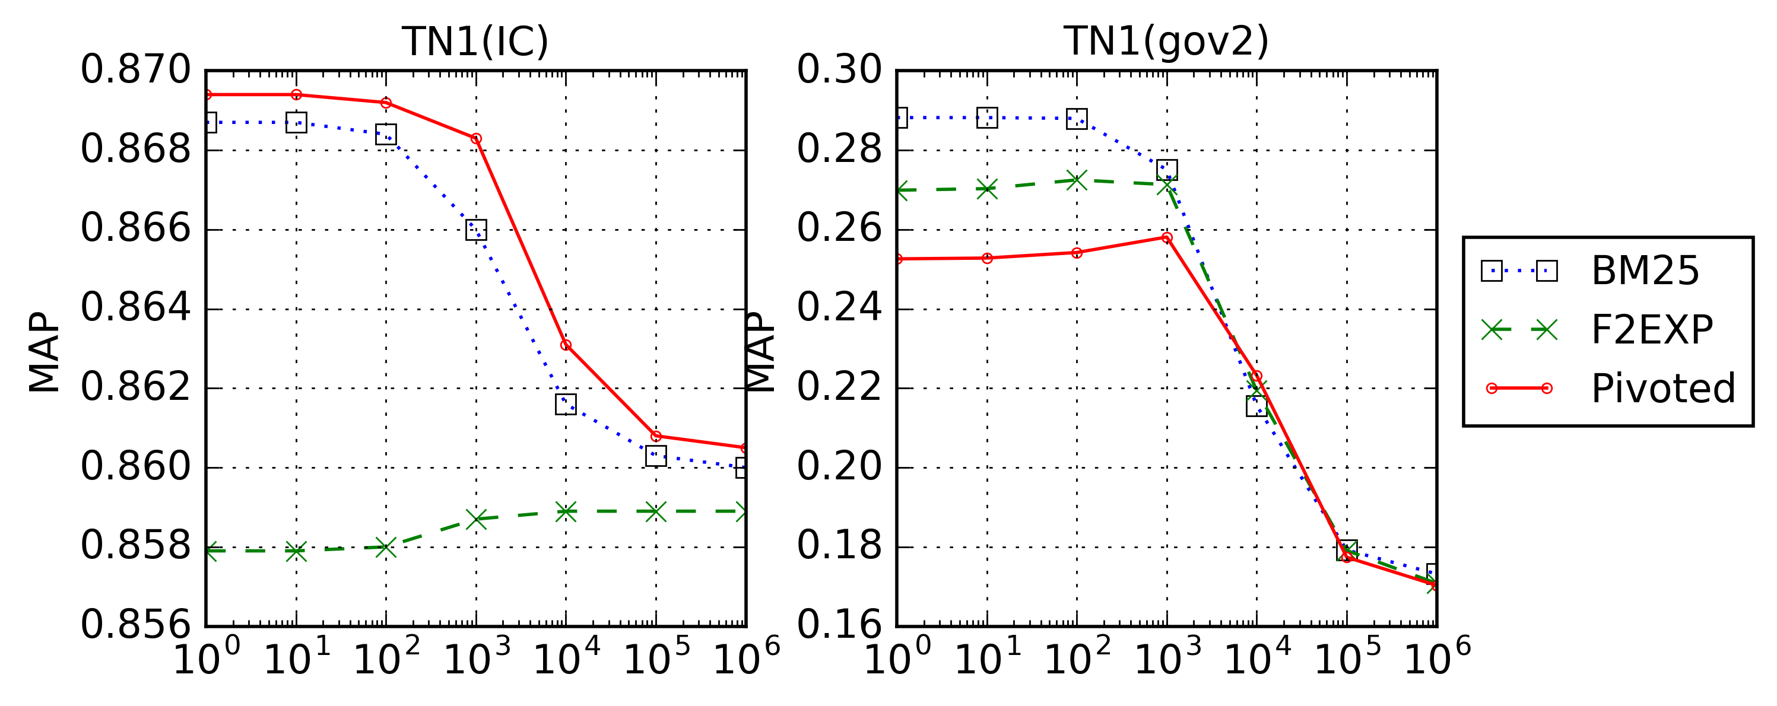
Diagnostic Analysis – TN1
Higher is Better
Means proper penalizing long documents
F2EXP performs not good on IC

Slide 27
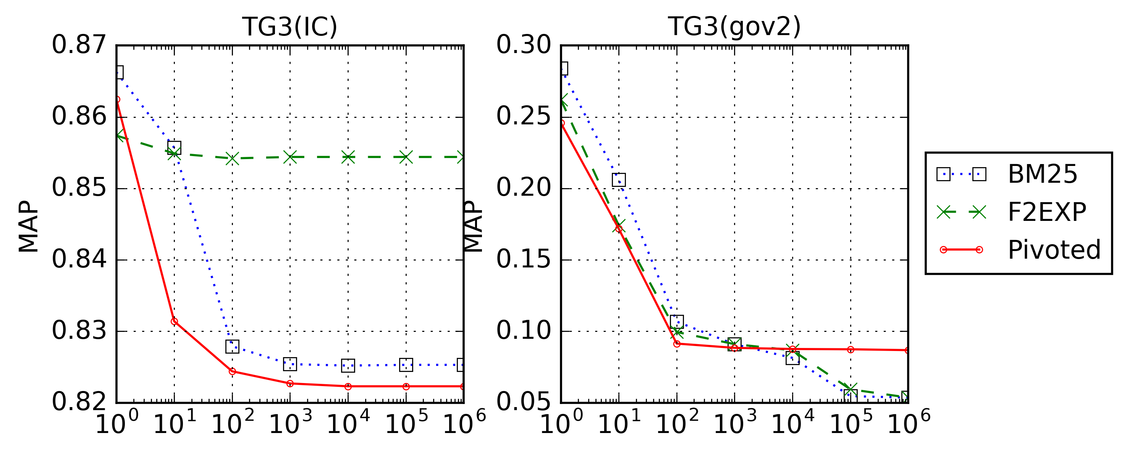
Diagnostic Analysis – TG3
Higher is Better
Means better balance of TF and LN
F2EXP performs good on IC

Slide 28
PPE - Conclusion
Level-based Framework
PPE can make private data available to others
Diagnostic analysis can make more use of the data
Try it out: https://rise.eecis.udel.edu/

Slide 29
Thank You!
Q & A

